Slide 1
Stephe/Grumps
Seventy Five Years Done

Slide 2
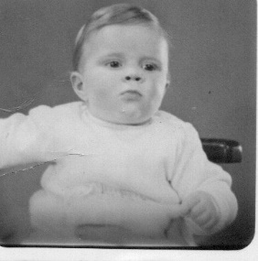
Born 30th August 1948; Bradford, Yorkshire

Slide 3
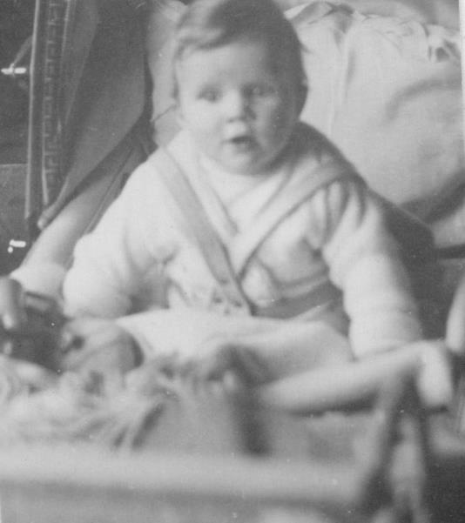
68, Prune Park Lane, Allerton, Bradford

Slide 4
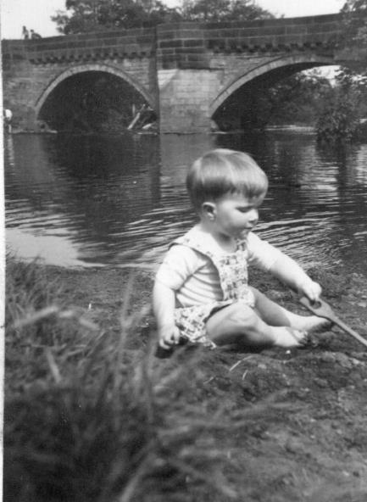
River Aire, Apperley Bridge, Bradford

Slide 5
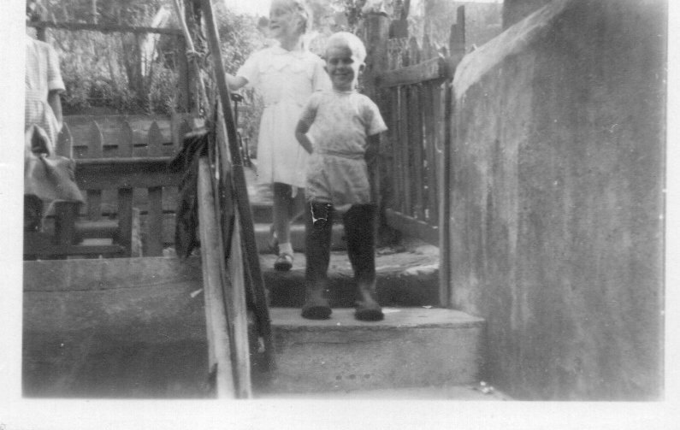
Grandad Cove’s wellies, with Liz; Craigland’s back yard, Salcombe

Slide 6
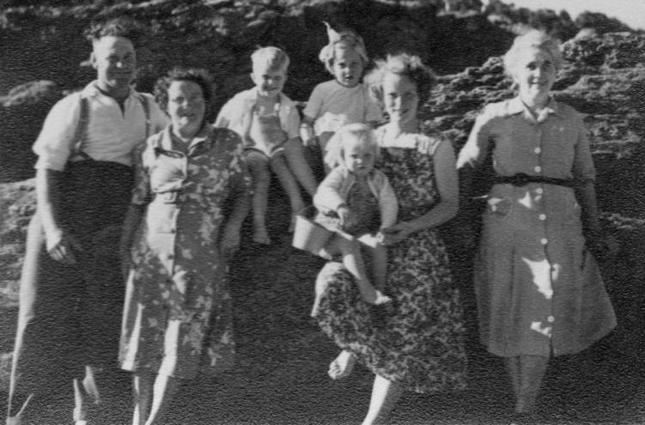
Grandad, Nanna, Grandma and mum with us; North Sands, Salcombe

Slide 7
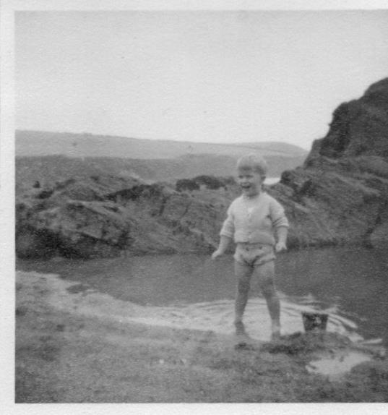
North Sands, Salcombe

Slide 8
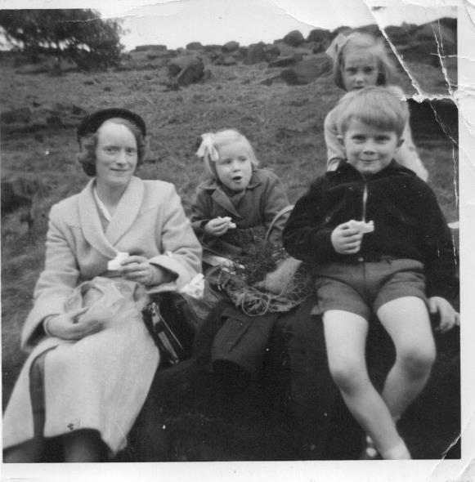
Mum, Alison and Liz; Shipley Glen, Bradford

Slide 9
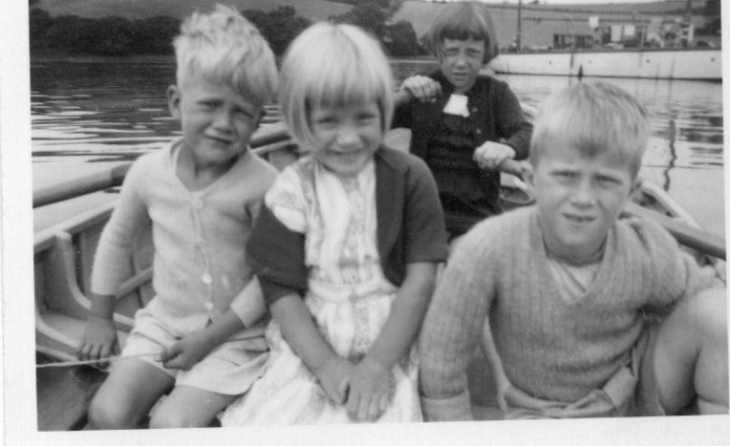
Peter, Alison and Liz; Batson Creek, Salcombe

Slide 10
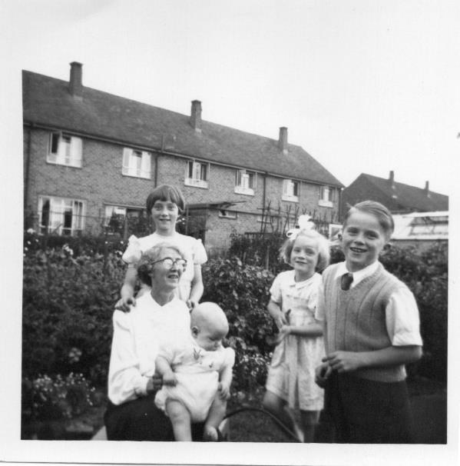
Aunty Alice, Liz, Willy and Alison; Shirley Road, Derby

Slide 11
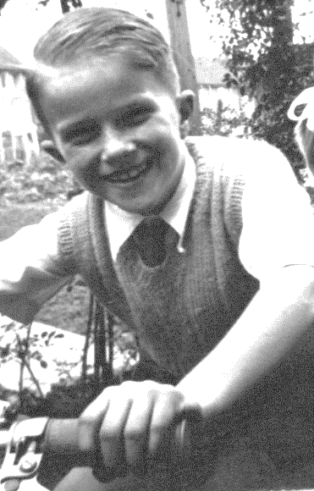
Unknown – probably with dad’s moped, Shirley Road, Derby

Slide 12
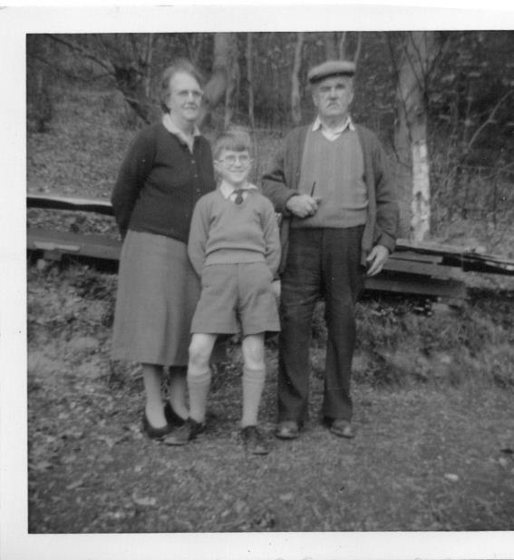
First glasses, Mr and Mrs Jones; Malvern Worcestershire

Slide 13
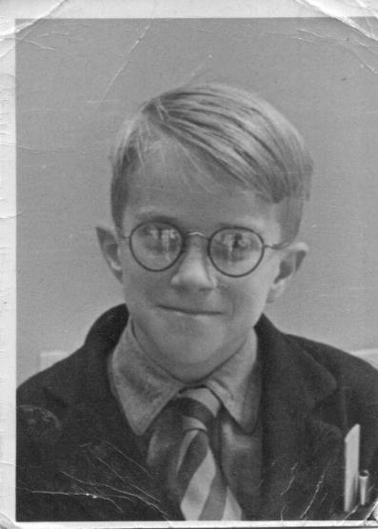
First year, Spondon Park Grammar School, Derby

Slide 14
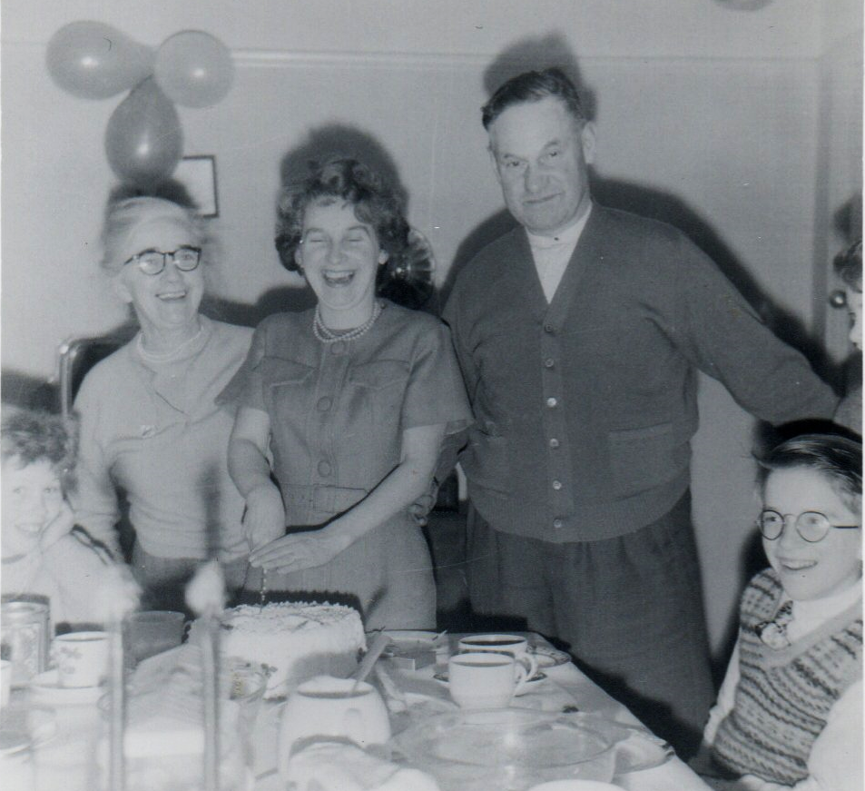
Christmas with Grandad, Grandma and Brenda; West Wickham

Slide 15
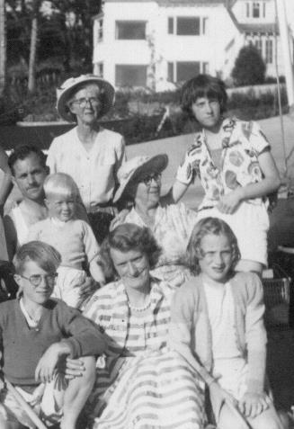
Alice, Grandmamma, Dad, Mum, Liz, Alison, Willy; Salcombe

Slide 16
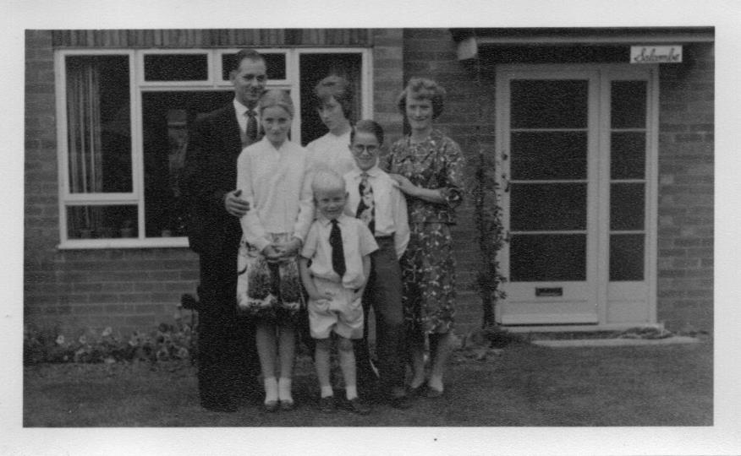
All of us; Tennessee Road, Chaddesden, Derby

Slide 17
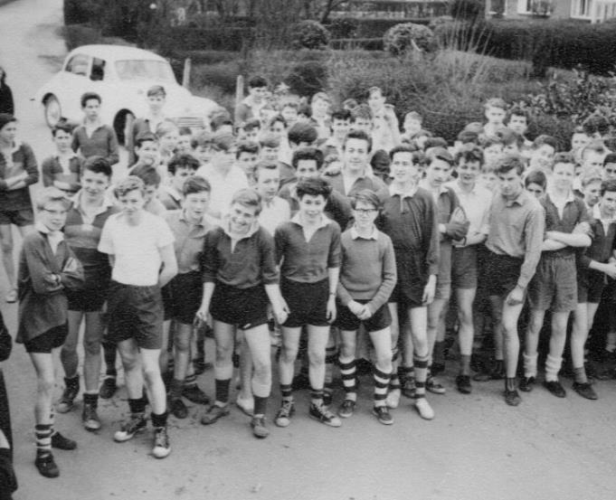
Spondon Park GS Cross Country – came 23rd

Slide 18
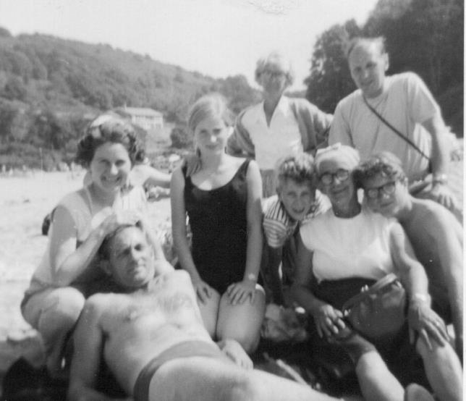
Alice, Mabel Annie, Brenda, Tim, dad, Peter, Alison; Mill Bay, Salcombe

Slide 19
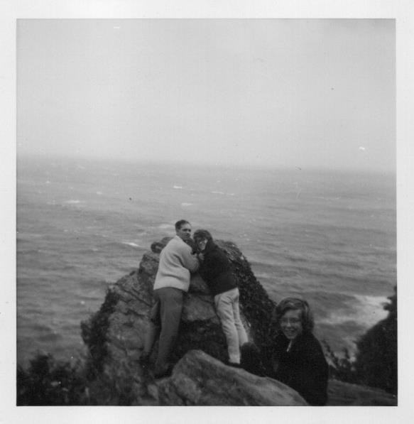
Dad and Lin Putt; Gara Rock, Salcombe

Slide 20
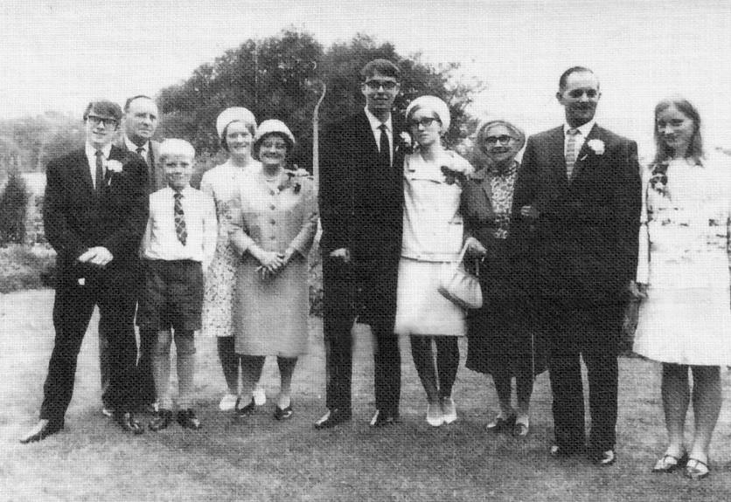
Liz & Tony wedding, 3 grandparents plus Coves; Tennessee Road

Slide 21
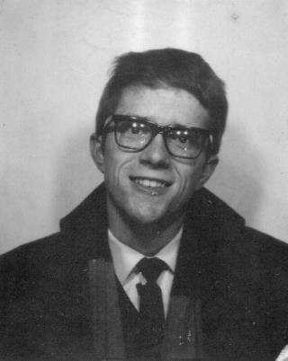
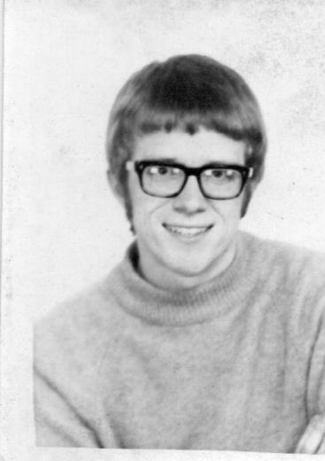
Still clean shaven while labouring after A levels

Slide 22
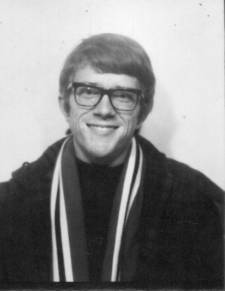
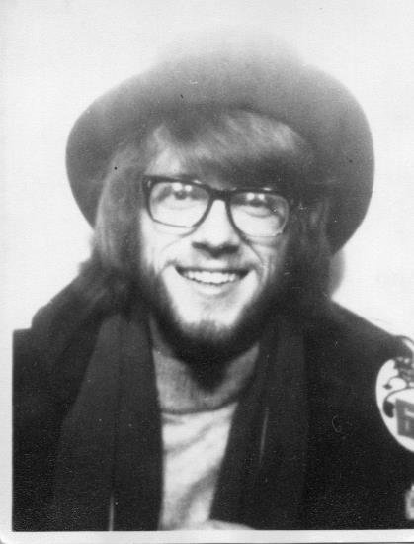
Decline and fall studying Sociology; Manchester Polytechnic

Slide 23
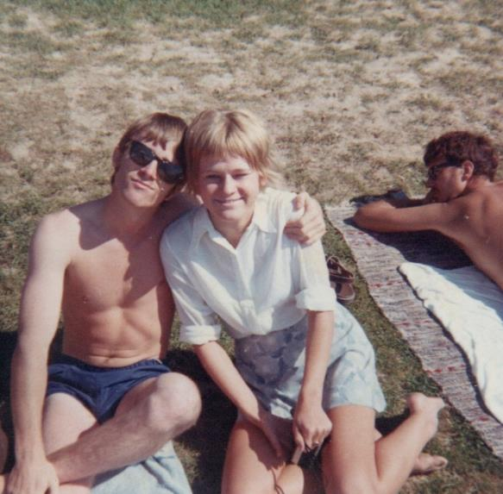
Posing with Marianne; Workcamp, Rattvik, Sweden

Slide 24
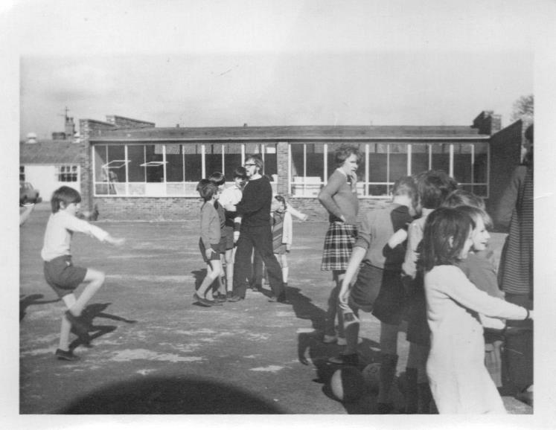
Teaching practice with Maggie; Skerton primary school, Lancaster

Slide 25
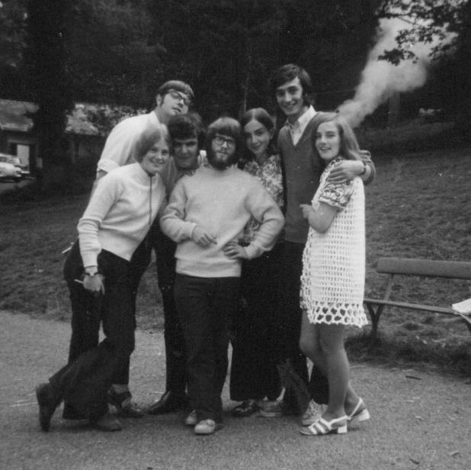
Assistant director, Colony Holidays where I met Mur; Linden Manor. Malvern

Slide 26
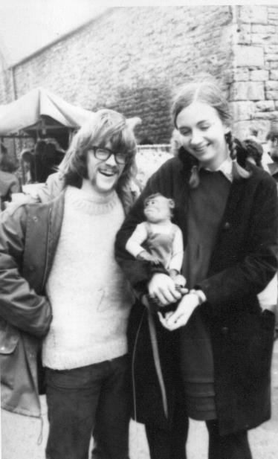
Bank Holiday meeting with the Monkey Man; Cockermouth

Slide 27
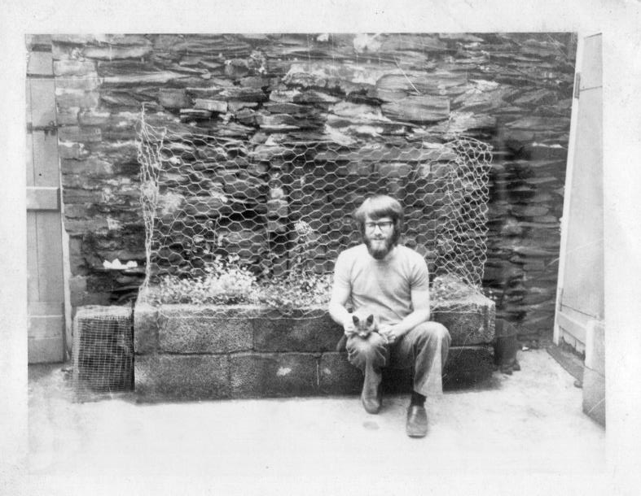
Ned, the Burmese Grey kitten; back yard Albert Street, Millom

Slide 28
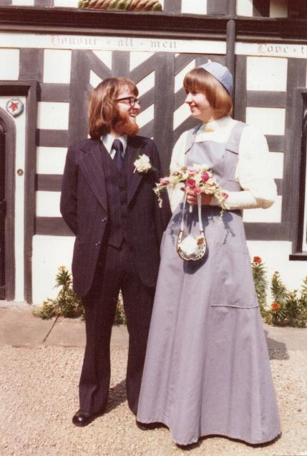
Wedding; Lord Leycester Hospital, Warwick

Slide 29
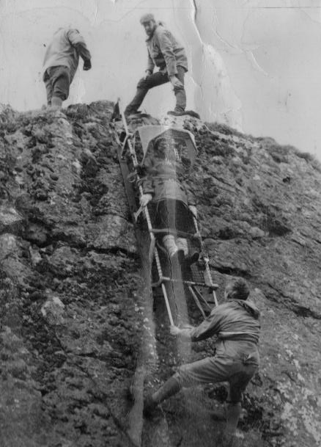
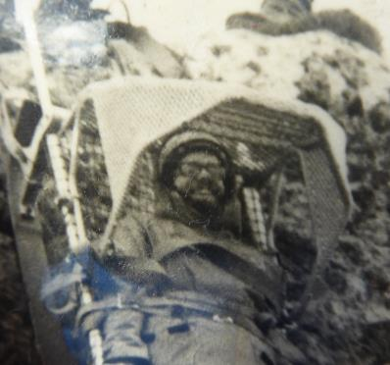
Stretcher lower with John Mitchell and Pete Jackson; Beck Quarry

Slide 30
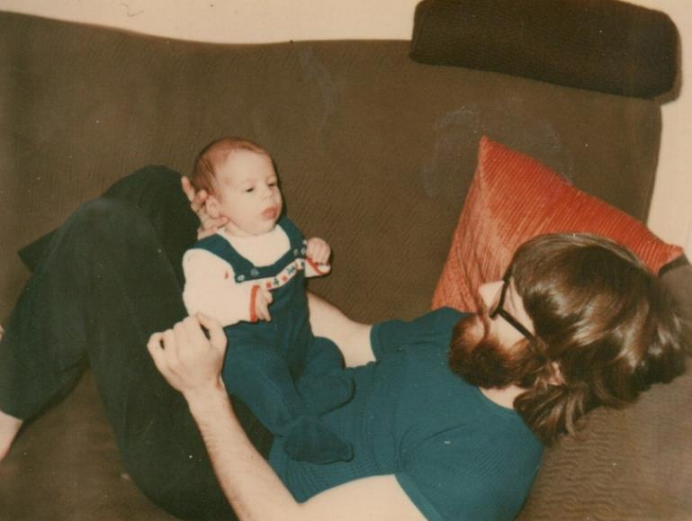
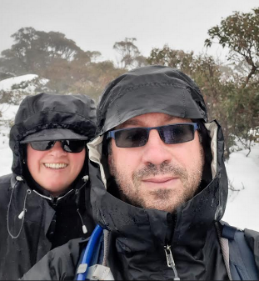
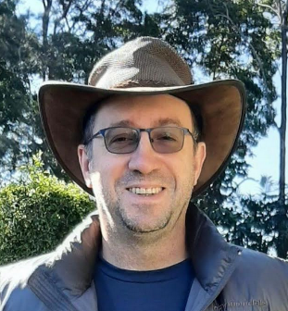
2022
With Tash
Ben was born in Whitehaven; home in Albert Street

Slide 31
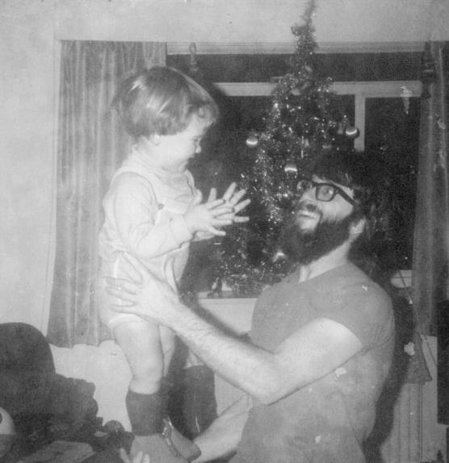
Circus Standing with Ben; Flavel Flat, Leamington Spa

Slide 32
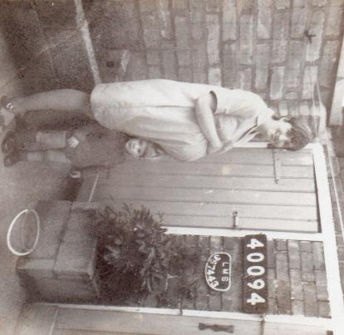
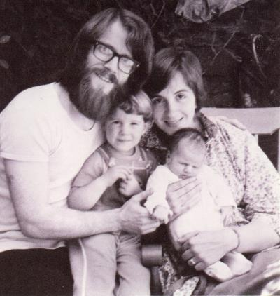
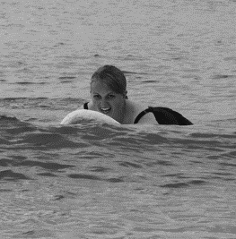
2023
Ten days apart – Sponsored walk launch of Sarah

Slide 33
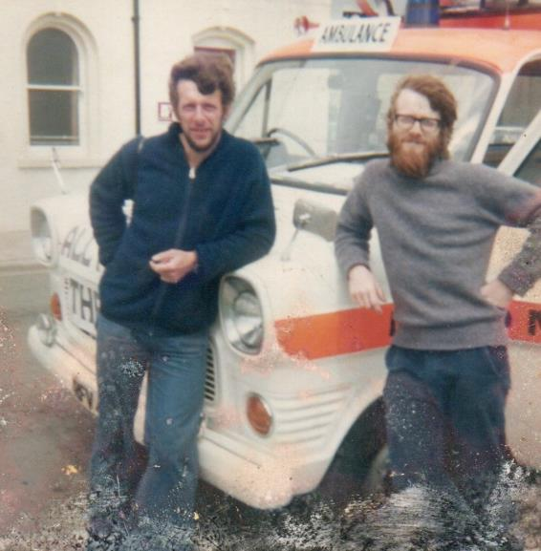
Rescue team transit with John Clemens

Slide 34
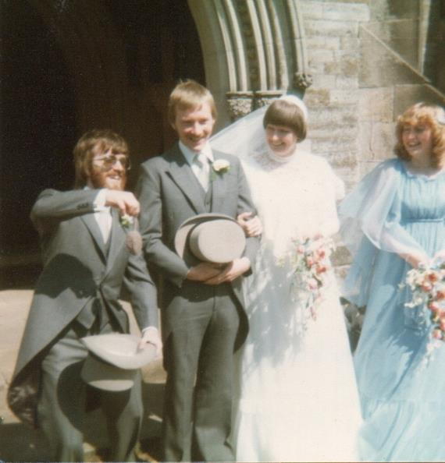
Mouse out of the hat at Willy’s wedding

Slide 35
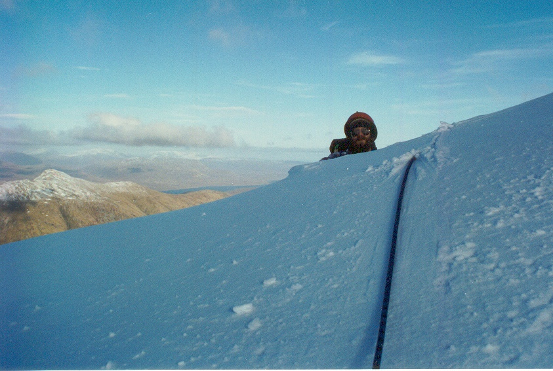
Ah those were the days when we had snow!

Slide 36
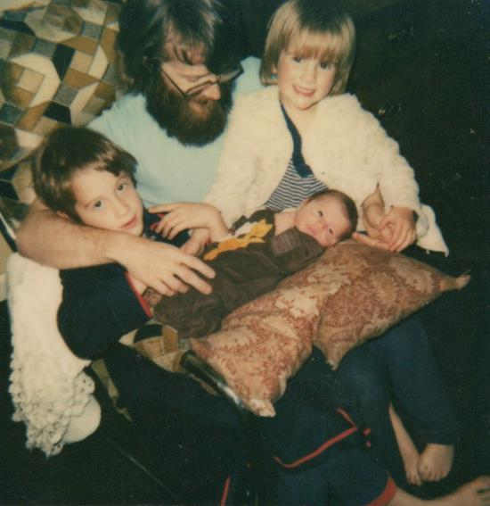
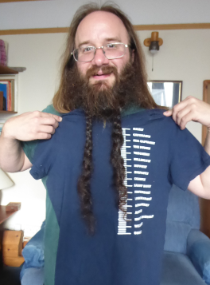
2023
Jommo born; I’d been hoping for a tumble drier

Slide 37
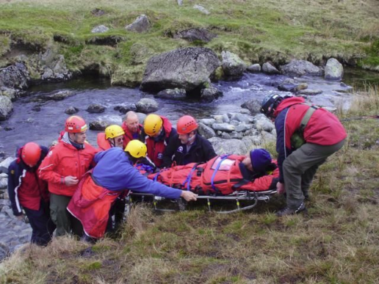
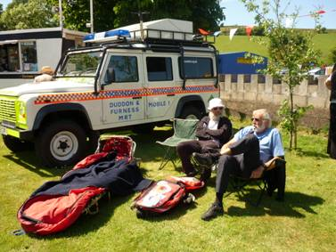
Two sides of Mountain Rescue; Green Village Show with PJ

Slide 38
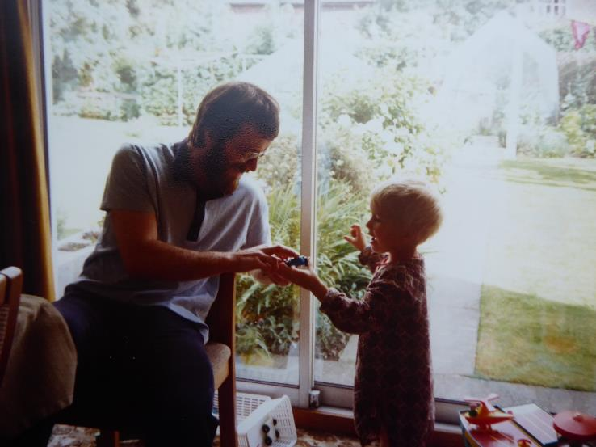
Christmas at Tennessee Road with Jon

Slide 39
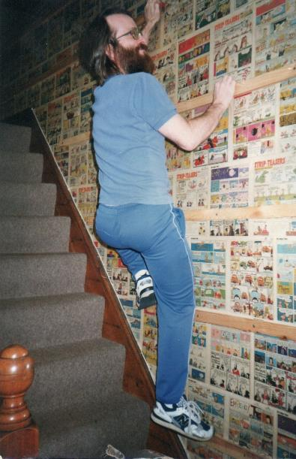
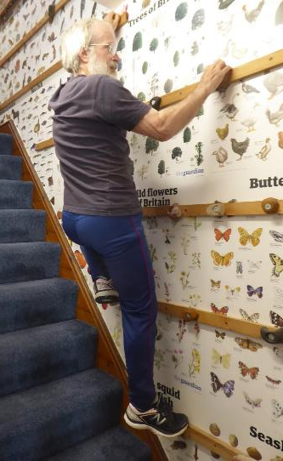
2023
Comic wallpaper and climbing wall; top landing, Kingsland Road

Slide 40
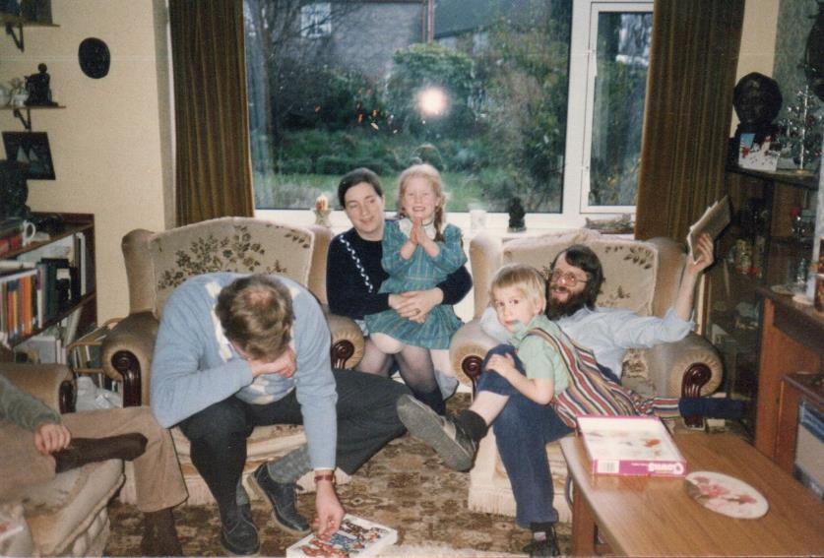
Alison, Ray, Janna, Jon; Tennessee Road, Derby

Slide 41
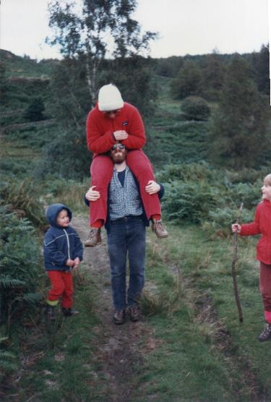
Piggy Back for Mur; Black Crag, above Tarn Hows, Coniston

Slide 42
Landing stage at the Boathouse; Normanton on Soar

Slide 43
First retiring presentation with Marie Magowan; Black Combe School

Slide 44
Plumbing with Readiheat; Cinder Hill, Broughton

Slide 45
Driving test passed at third attempt with Jon and Janna

Slide 46
Holiday to South Wales; Tenby, Pembrokeshire

Slide 47
Sponsored beard trim, £75 raised; Coniston CE School Summer Fair

Slide 48
The felt hat nearing the end of its days

Slide 49
Legoland trip to Denmark with Jon

Slide 50
Mum and Dad’s Golden Wedding

Slide 51
Three Monkeys trip to Paris on Eurostar –John, Pam and David

Slide 52
Salcombe? Dad’s ashes – white hat

Slide 53
Two extremes – Ledge Route, Ben Nevis and Smith’s Barcadere, Grand Cayman

Slide 54
The Millennium Tie and Ann Jackson

Slide 55
Family gathering with Chris, Rachael and Janna

Slide 56
Hame and Gerry on the sofa; Kingsland Road, Millom

Slide 57
Only ever package holiday; Grand Canaria

Slide 58
2023
Annabelle, Tinkerbelle, Tink is born; first visit to Millom

Slide 59
Wedding tie (now 31 years old) at Simon and Eley’s wedding;

Slide 60
A winter stroll with Dave and Ben; Ben Lawyers

Slide 61
Tink at Haverigg and bubbles at Coniston School

Slide 62
2023
I’m sixty and retire again and William is born

Slide 63
Mur records me recording exciting things for “Anorak” talk

Slide 64
Sally and Mike’s wedding, Chester

Slide 65
Canada rail trip – Quebec and Cape Breton

Slide 66
Romans in Ravenglass Archaeological dig

Slide 67
Another picnic in France with Dave and Ruth

Slide 68
Little sign that the decorations raised the Christmas spirit

Slide 69
Cycling home from Aberdeen – the first pedal stroke

Slide 70
4000 year old charcoal fragments; DuddonDig Longhouse site

Slide 71
Working in school with DuddonDig project – excavating treasure!

Slide 72
Forget a hat – a duster will do

Slide 73
Community Archaeology Award for the Duddon Dig with Ken Day

Slide 74
Covid pandemic, lockdown, Sankey photo project and Zoom calls

Slide 75
Another Christmas paddle at Silecroft; compared with M&E in Cayman

Slide 76
Washfold project; Sling Beck, Crowberry Hill

Slide 77
Meals on wheels in Millom – memories of dad

Slide 78
The thing that I wish I’d seen more of…
Winters 2013 and 2017

